Slide 1

INTRO TO
PYTHON
Section Four

Slide 2
Python Set
A Python set is the collection of the unordered items. Each element in the set must be unique, immutable, and the sets remove the duplicate elements. Sets are mutable which means we can modify it after its creation.
Unlike other collections in Python, there is no index attached to the elements of the set, i.e., we cannot directly access any element of the set by the index. However, we can print them all together, or we can get the list of elements by looping through the set.

Slide 3
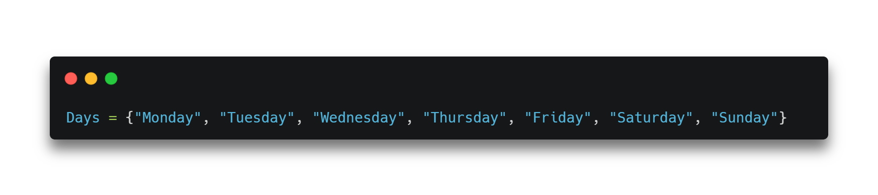
Syntax of Set
The set can be created by enclosing the comma-separated immutable items with the curly braces {}. Python also provides the set() method, which can be used to create the set by the passed sequence.

Slide 4
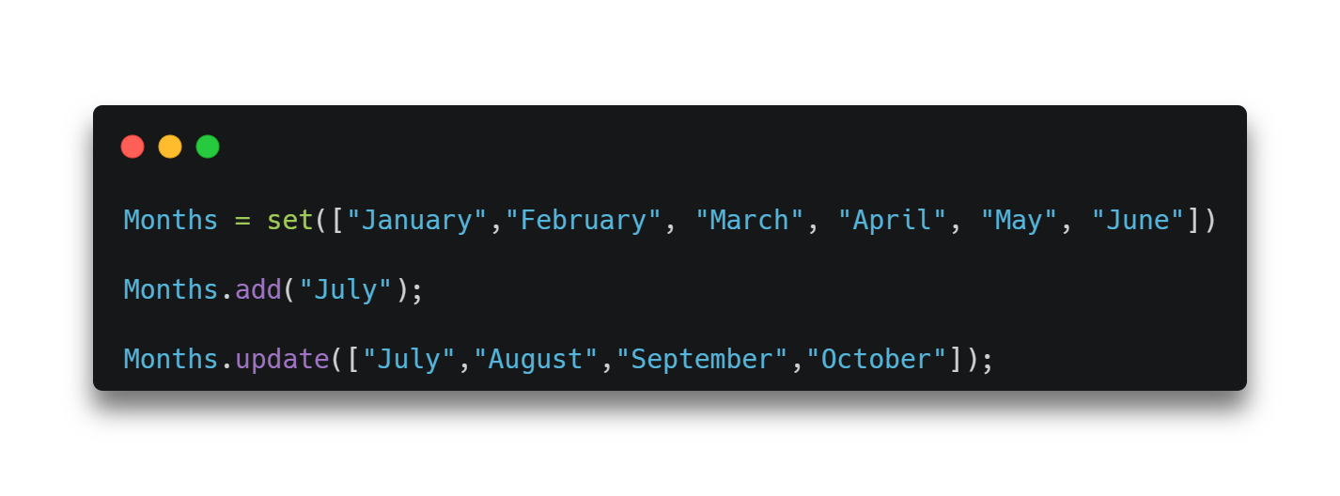
Adding items to the set
Python provides the add() method and update() method which can be used to add some particular item to the set. The add() method is used to add a single element whereas the update() method is used to add multiple elements to the set. Consider the following example.

Slide 5
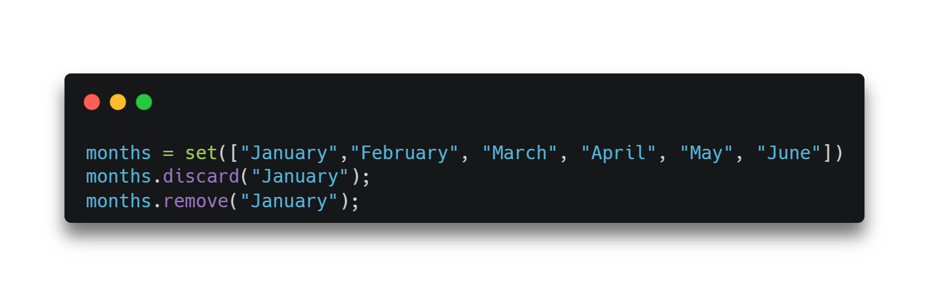
Removing items from the set
Python provides the discard() method and remove() method which can be used to remove the items from the set. The difference between these function, using discard() function if the item does not exist in the set then the set remain unchanged whereas remove() method will throw an error.

Slide 6
Activity
#given set
sample_set = {"Yellow", "Orange", "Black"}
Exercise 1: Add a list of elements to a set
Exercise 2: Remove item orange from the set

Slide 7

Python Set Operations
Set can be performed mathematical operation such as union, intersection, difference, and symmetric difference. Python provides the facility to carry out these operations with operators or methods.

Slide 8
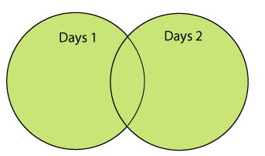
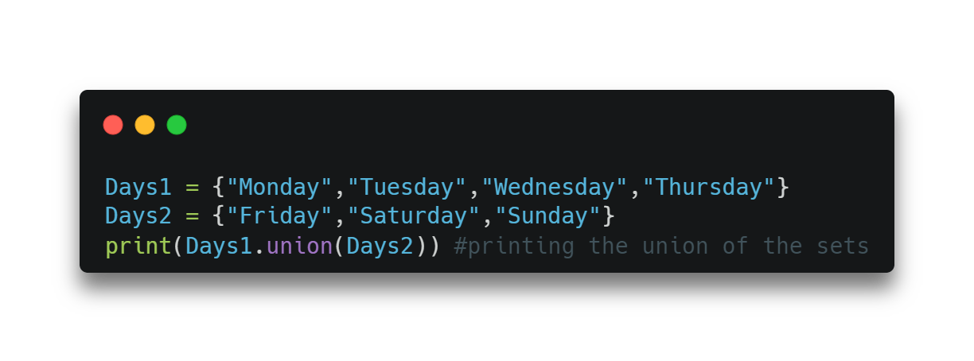
Union of two Sets
To combine two or more sets into one set in Python, use the union() function. All of the distinctive characteristics from each combined set are present in the final set. As parameters, one or more sets may be passed to the union() function. The function returns a copy of the set supplied as the lone parameter if there is just one set. The method returns a new set containing all the different items from all the arguments if more than one set is supplied as an argument.

Slide 9
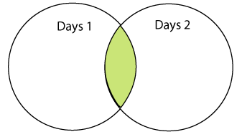
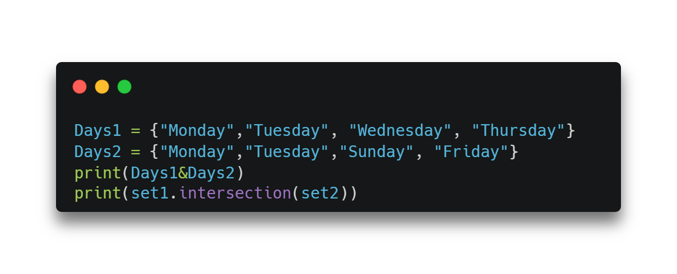
The intersection of two sets
Only the items in all sets being compared are included in the final set. One or more sets can also be used as the intersection() function parameters. The function returns a copy of the set supplied as the lone parameter if there is just one set. The method returns a new set that only contains the elements in all the compared sets if multiple sets are supplied as arguments.
The intersection of two sets can be performed by the and & operator or the intersection() function. The intersection of the two sets is given as the set of the elements that common in both sets.

Slide 10
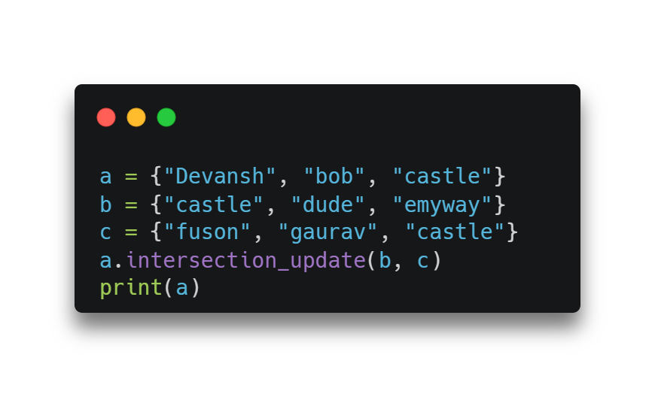
The intersection_update() method
The intersection_update() method removes the items from the original set that are not present in both the sets (all the sets if more than one are specified).
The intersection_update() method is different from the intersection() method since it modifies the original set by removing the unwanted items, on the other hand, the intersection() method returns a new set.

Slide 11
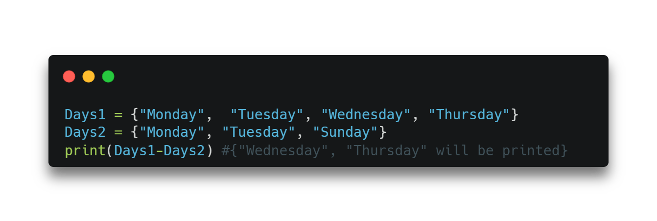
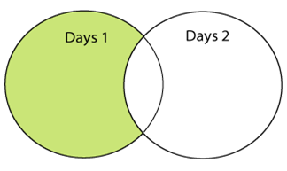
Difference between the two sets
The difference of two sets can be calculated by using the subtraction (-) operator or difference () method. Suppose there are two sets A and B, and the difference is A-B that denotes the resulting set will be obtained that element of A, which is not present in the set B.

Slide 12
Activity
#given set
sample_set_A= {"Yellow", "Orange", "Black"}
sample_set_B= {“Black", “Blue", “Yellow"}
Exercise 1: Return a set of elements present in Set A or B, but not both
Exercise 2: Check if two sets have any elements in common. If yes, display the common elements
Exercise 3: Update setA by adding items from setB, except common items
Exercise 4: Remove items from setA that are not common to both setA and setB

Slide 13

PYTHON DICTIONARY

Slide 14
Python Dictionary
Dictionaries are a useful data structure for storing data in Python because they are capable of imitating real-world data arrangements where a certain value exists for a given key.
The data is stored as key-value pairs using a Python dictionary.
This data structure is mutable
The components of dictionary were made using keys and values.
Keys must only have one component.
Values can be of any type, including integer, list, and tuple.

Slide 15
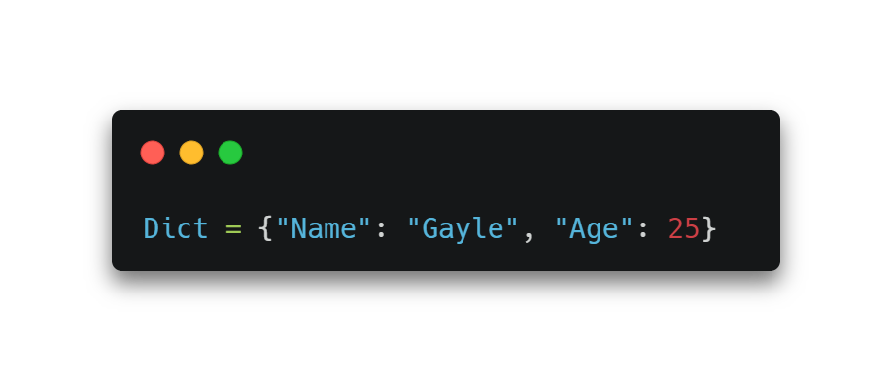
Creating the Dictionary
Curly brackets are the simplest way to generate a Python dictionary, although there are other approaches as well. With many key-value pairs surrounded in curly brackets and a colon separating each key from its value

Slide 16
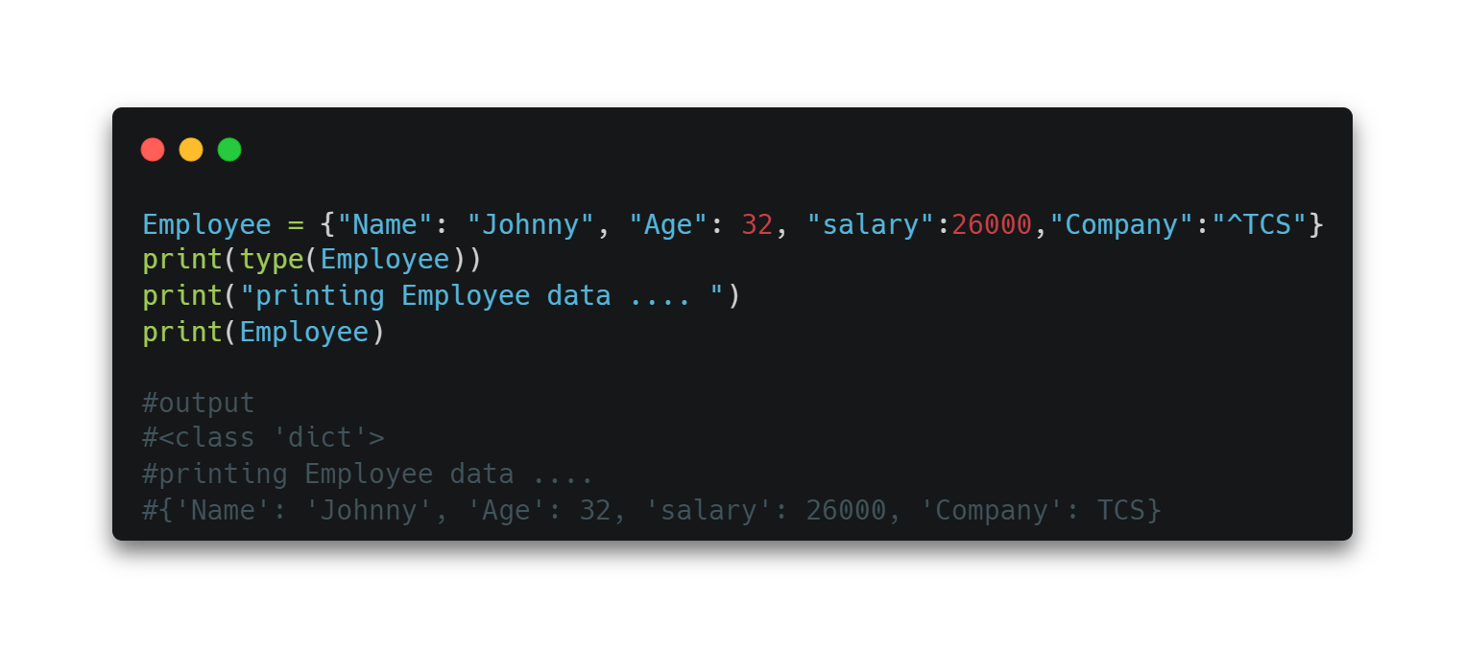
Example

Slide 17
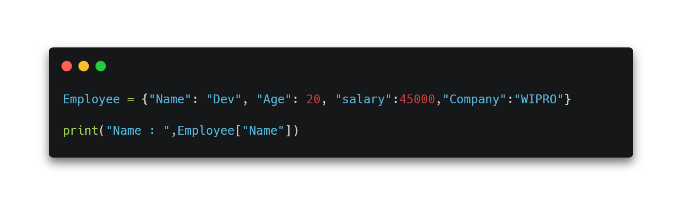
Accessing the dictionary values
To access data contained in lists and tuples, indexing has been studied. The keys of the dictionary can be used to obtain the values because they are unique from one another. The following method can be used to access dictionary values.

Slide 18
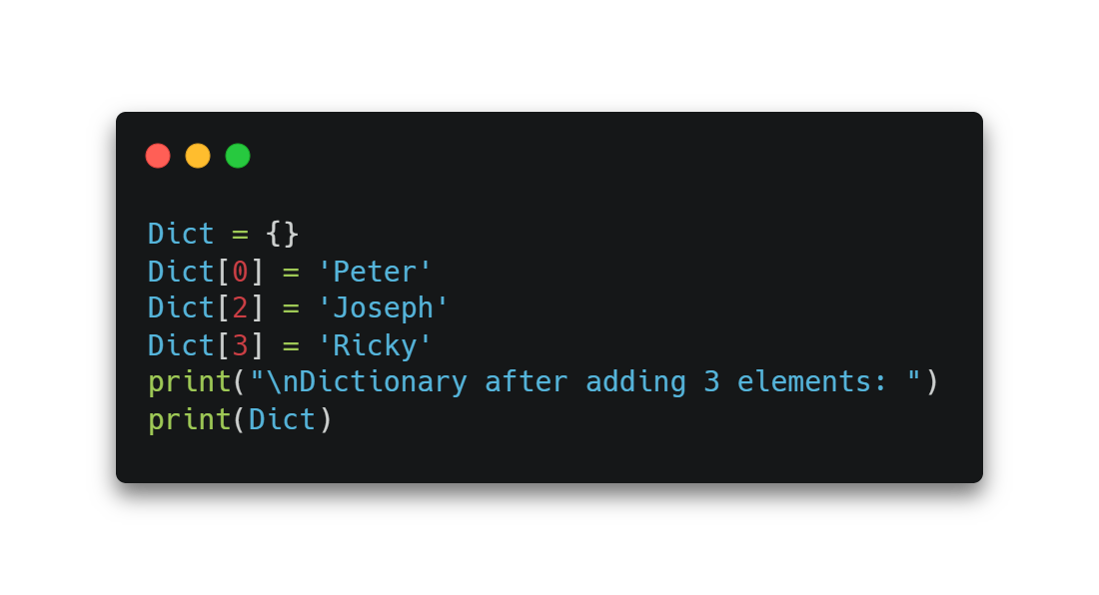
Adding Dictionary Values
The dictionary is a mutable data type, and utilising the right keys allows you to change its values. Dict[key] = value and the value can both be modified. An existing value can also be updated using the update() method.if the key-value pair is not present it will add new one.

Slide 19
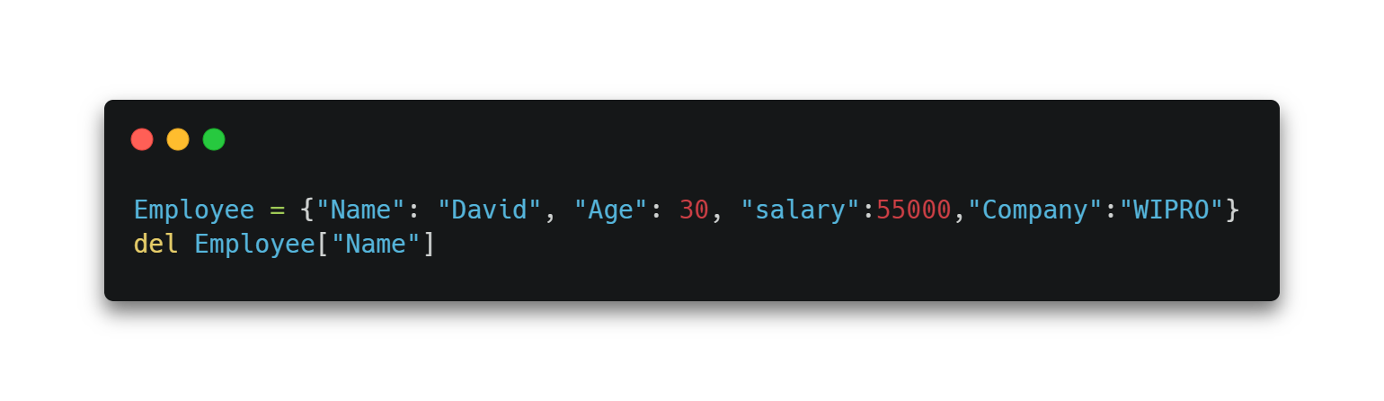
Deleting Elements
The items of the dictionary can be deleted by using the del keyword as given below.

Slide 20
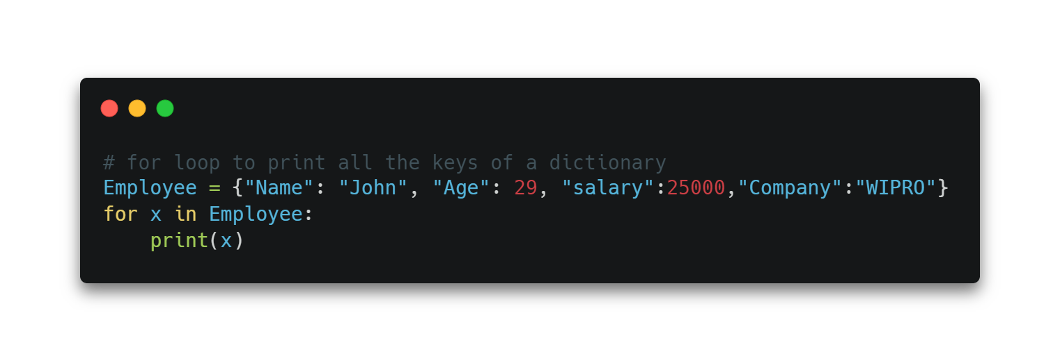
Iterating Dictionary
A dictionary can be iterated using for loop as given below.

Slide 21
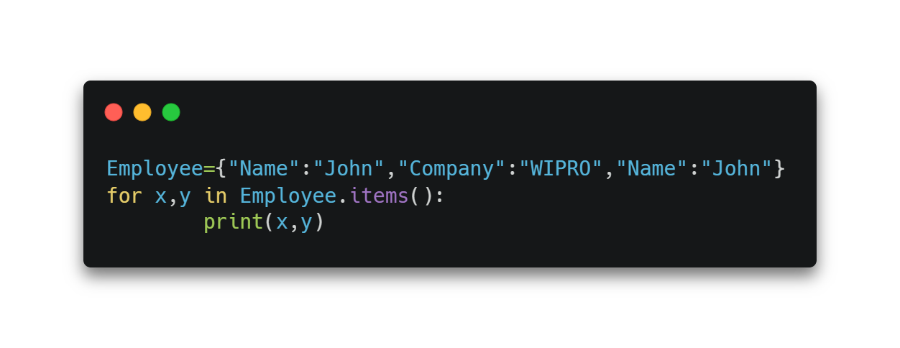
Properties of Dictionary Keys
1. In the dictionary, we cannot store multiple values for the same keys. If we pass more than one value for a single key, then the value which is last assigned is considered as the value of the key.

Slide 22
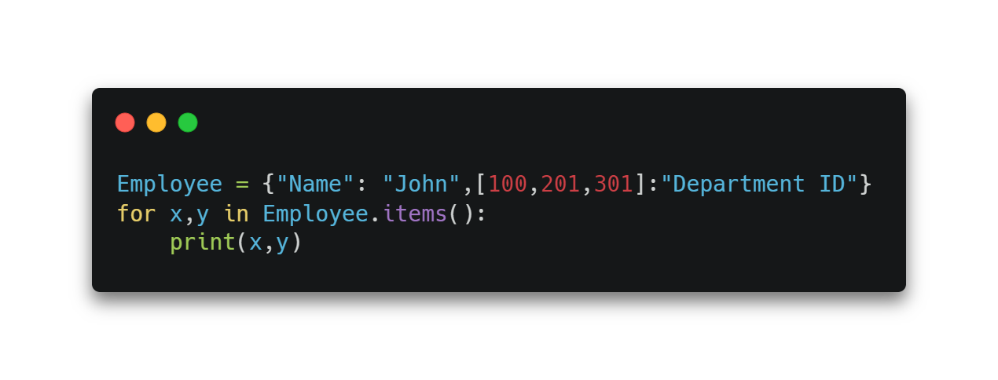
Properties of Dictionary cont.
2. The key cannot belong to any mutable object in Python. Numbers, strings, or tuples can be used as the key, however mutable objects like lists cannot be used as the key in a dictionary.

Slide 23
Activity 1
#Exercise 1: Convert two lists into a dictionary
Below are the two lists. Write a Python program to convert them into a dictionary in a way that item from list1 is the key and item from list2 is the value
keys = ['Ten', 'Twenty', 'Thirty']
values = [10, 20, 30]

Slide 24
Activity 2
#Exercise 2: Merge two Python dictionaries into one
dict1 = {'Ten': 10, 'Twenty': 20, 'Thirty': 30}
dict2 = {'Thirty': 30, 'Fourty': 40, 'Fifty': 50}
#Expected output
{'Ten': 10, 'Twenty': 20, 'Thirty': 30, 'Fourty': 40, 'Fifty': 50}

Slide 25
Activity 3
Exercise 2: Print the value of key ‘history’ from the below dict
sampleDict = {
"class": {
"student": {
"name": "Mike",
"marks": {
"physics": 70,
"history": 80
}
}
}
}

